Slide 1
Luxury Consumption in the Context of the COVID-19 Pandemic
A scientific study on consumption of luxury products during pandemics.

Slide 2
Abstract
In this study, we examine the main factors affecting consumers’ attitudes toward and purchase intentions for luxury goods in the context of the COVID-19 pandemic. A sample of 320 respondents completed an online survey using a Qualtrics panel. Data were analyzed through the two-stage approach of Structural Equation Modeling (SEM) using SPSS and AMOS. The results indicated that materialism is the primary driver of consumers’ attitudes toward luxury goods and their purchase intentions during the pandemic. The study concludes with limitations and future research recommendations following the presentation of the theoretical, practical, and methodological implications.

Slide 3
Literature Review
Previous studies have contributed to the understanding of the effects of pandemics on investments, and consumers’ purchasing behavior of essential goods. However, consumers’ purchasing behavior towards luxury products has not being studied yet. Research on this topic will provide guidance not only for policymakers to counteract panic buying but also for practitioners in the luxury industry. To explain consumers’ purchasing patterns during a pandemic, the most valid model that was identified was the Theory of Reasoned Action (TRA). TRA identifies two underlying factors of attitude and subjective norms that affect an individual’s intended behavior.

Slide 4
Hypothesis
Materialism has a positive effect on consumers’ attitudes toward luxury goods
Social consumption motivation has a positive effect on consumers’ attitudes toward luxury goods.
Attitude toward luxury goods has a positive effect on consumers' purchase intentions.
Intolerance of uncertainty significantly moderates the relationship between attitude toward luxury and consumers’ luxury purchase intention.
Parenthood significantly moderates the relationship between attitude toward luxury and consumers’ luxury purchase intention.

Slide 5
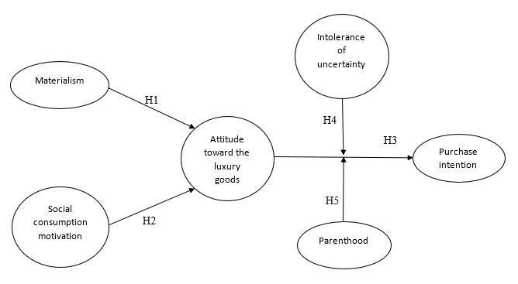
Conceptual Model

Slide 6
Research Methods
The data was collected during the first week of April 2020.
A self-administered questionnaire was designed to test our model. To obtain quality data, a Qualtrics online panel was used for data collection.
The criteria for our population selection was adults aged 18 years old and above who are residing in the US with a household income of $130,000 to represent the upper-middle-class population in the US.

Slide 7
Analyses and Results
The results indicate that our sample was mostly between the range age of 35-44 years old.
They mainly were males (58.1%) than females (41.9%). Furthermore, the participants were majorly holding master’s degree and above, which reveals that our sample tends to be skewed toward the educated population.
Regarding the marital status, our sample was comprised of (85%) married or domestic partner couples. Additionally, (89.9%) of them were a parent vs. (19.1%) were non-parent participants.

Slide 8
Socio-Demographic Characteristics

Slide 9
Descriptive Statistics and Correlations
Constructs | AVG | SD | AVE |  |  |  | 1 | 2 | 3 | 4 | 5
1. Materialism 2.Social Consumption Motivation | 3.30 3.57 | .92 .95 | .67 .73 |  |  | (.86) .71** |  | (.93)
3. Attitude toward Luxury Goods | 3.37 | .75 | .63 |  |  | .57** |  | .13* | (.69)
4. Purchase Intentions | 3.32 | .83 | .76 |  |  | .61** |  | .38** | .54** | (.94)
5. Intolerance of Uncertainty | 4.01 | .89 | .74 |  |  | .65** |  | .56** | .59** | .44** |  | (.91)

Slide 10
Limitations and Future Research
Responses filtered based on participants’ household income
The sample used in the data is considered a large sample
The results of this study are attributed to the US society
Future investigations should expand the size of the sample

